Slide 1


NYC Municipal Employee’s Salary Prediction
By: Ruth Iang
DATA 603

Slide 2

Goal
Goal: Predict the salary for municipal jobs in NYC
Public interest in city budget for all municipal employees
Data: Office of Payroll Administration (OPA) from NYC Open data

Slide 3

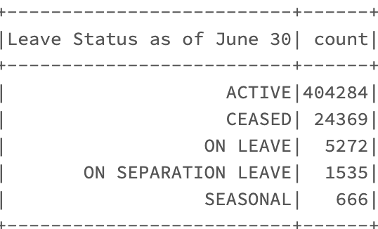
Data Cleaning
17 columns, then 9 columns
Drop null values
Extract the year from ”agency start date”. Subtract it from fiscal year. Create experience job
Keep active personnel

Slide 4
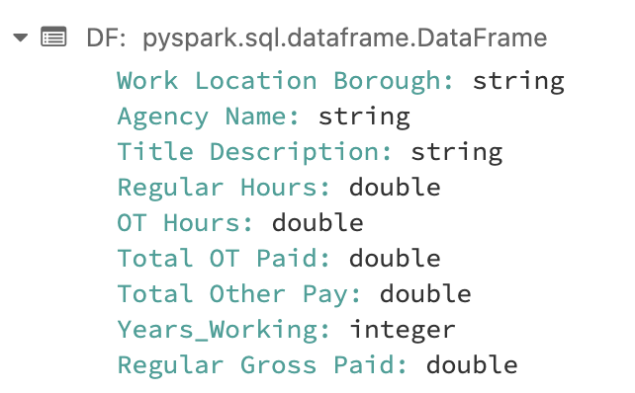
Data Cleaning
Drop employees where regular hours, OT hours, Total OT paid, and Total other Pay are less than 0.
Only boroughs, agencies and job titles with the most employees were kept
16 boroughs, and 700+ jobs
Curse of dimensionality: More features, data becomes scattered, and overfitting becomes a problem.

Slide 5
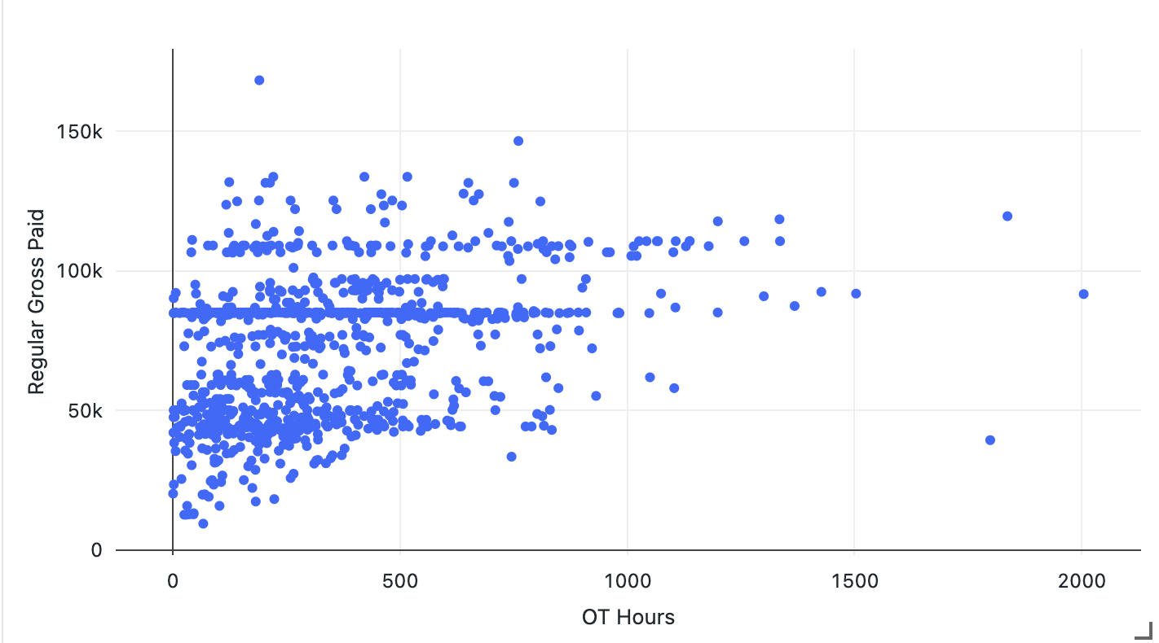
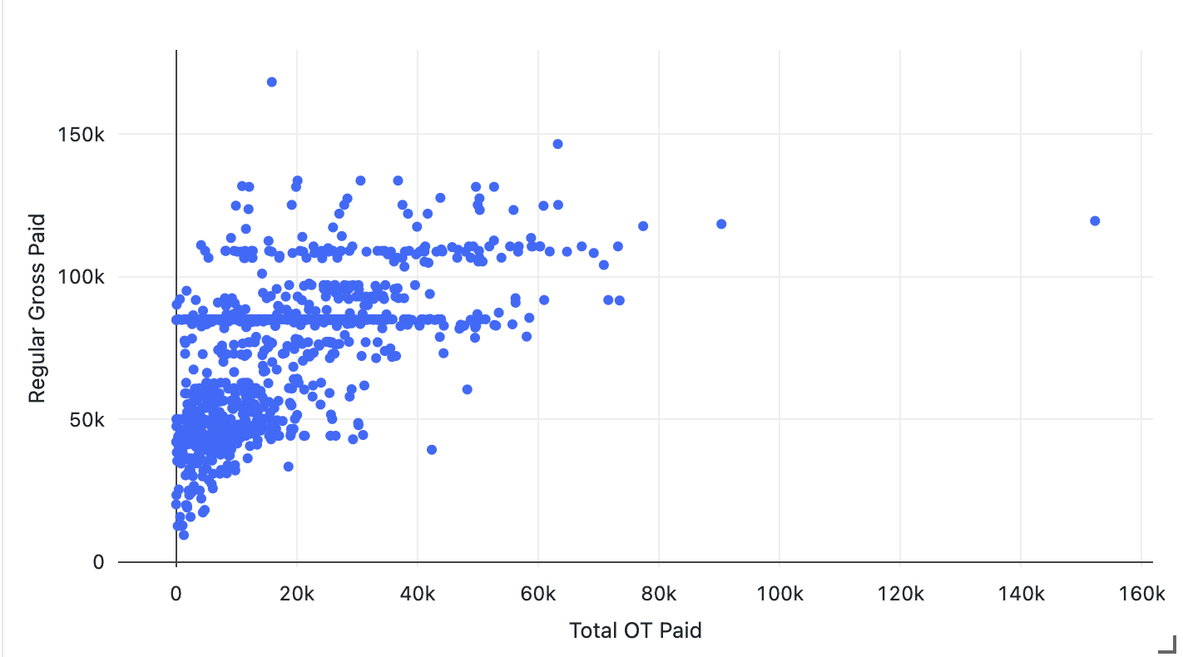
Exploratory Data Analysis Using Scatterplot

Slide 6
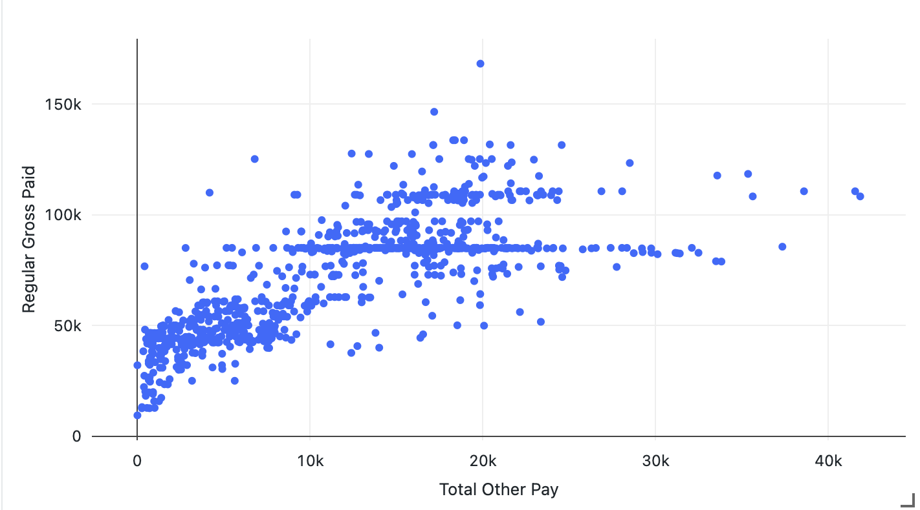
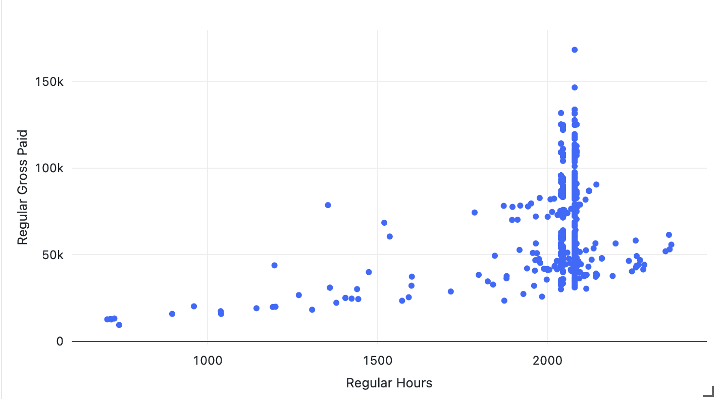
Exploratory Data Analysis Using Scatterplot

Slide 7
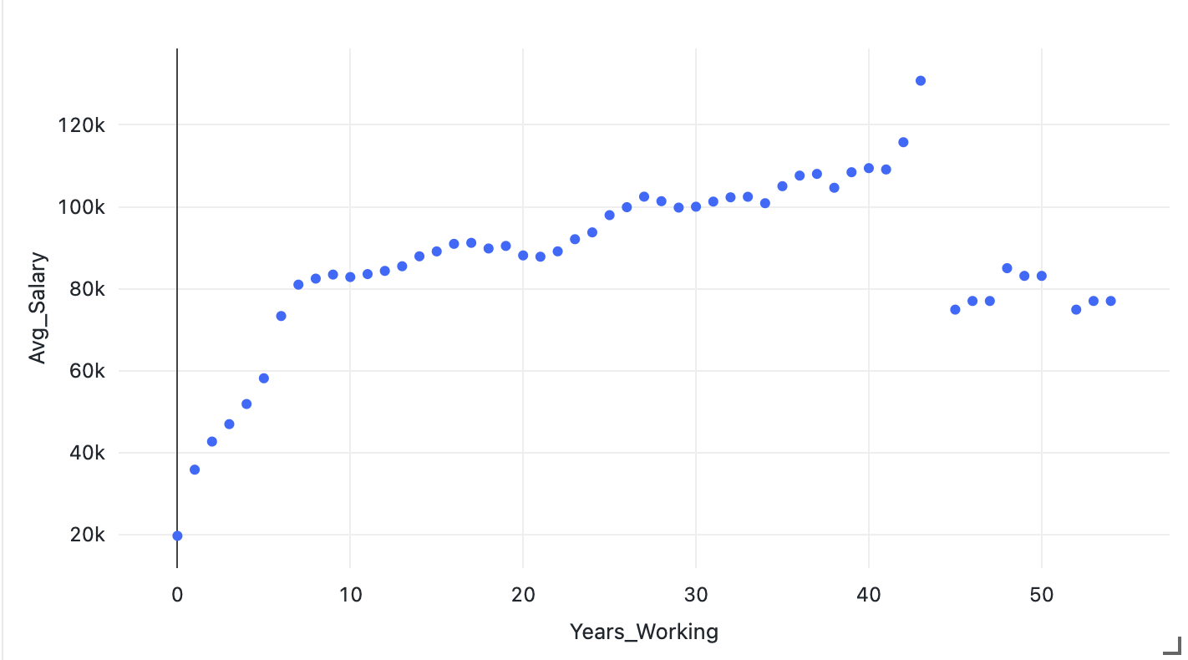
Years Working Exploratory Data Analysis

Slide 8
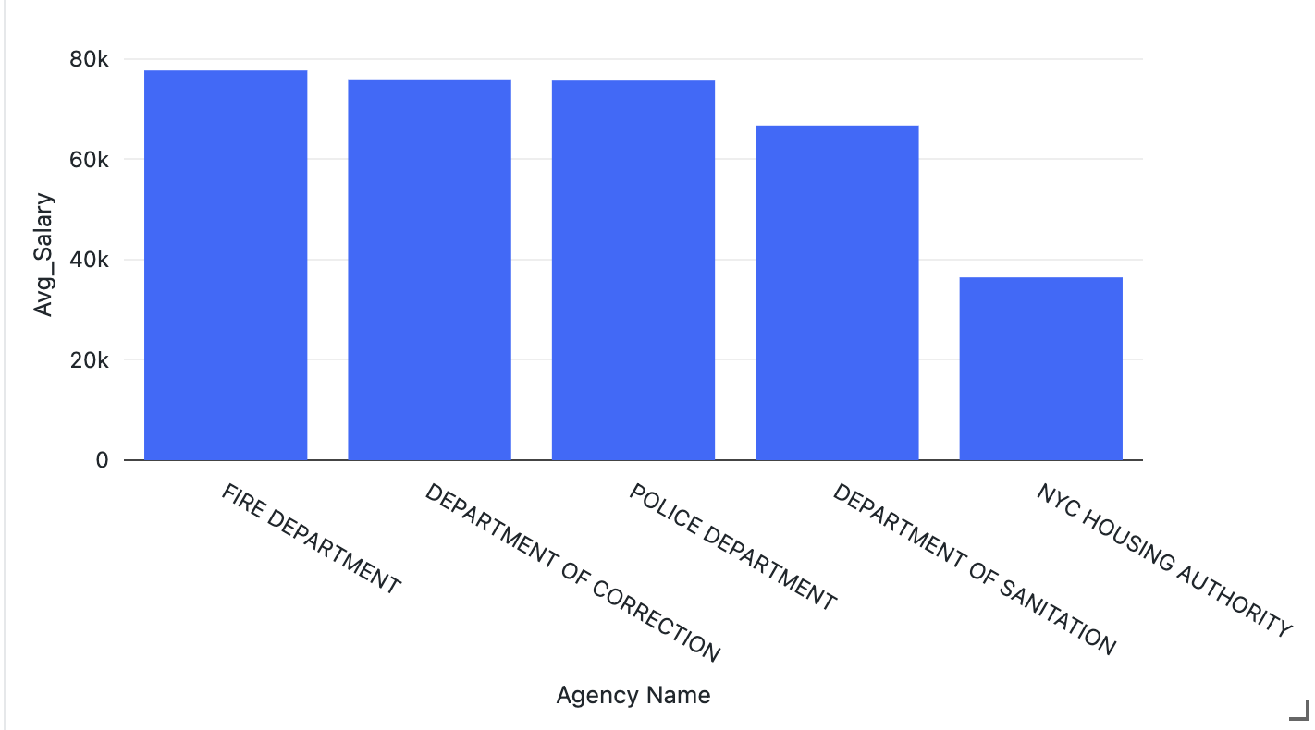
Agency Exploratory Data Analysis

Slide 9
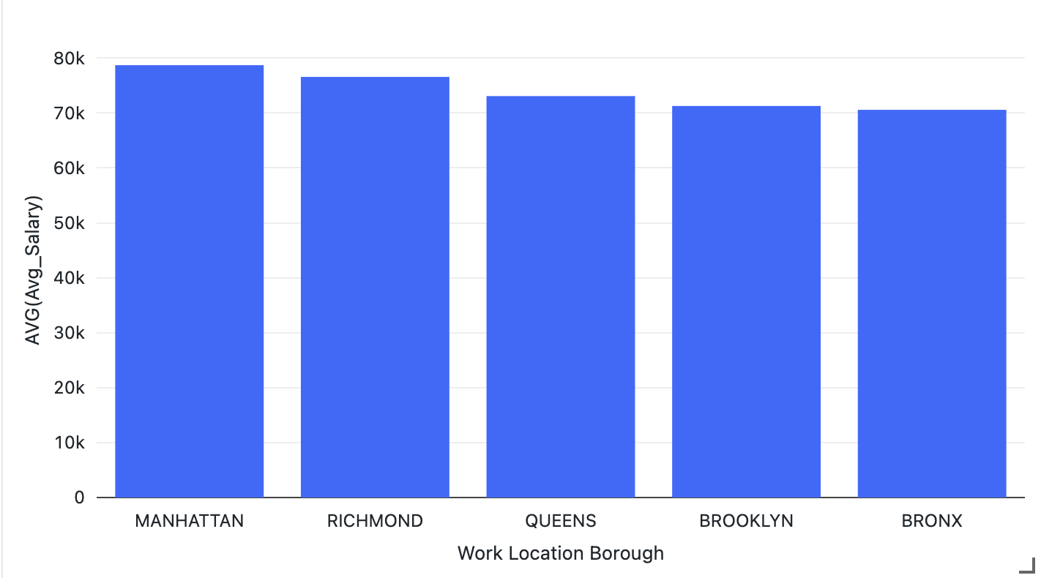
Work Location Exploratory Data Analysis

Slide 10
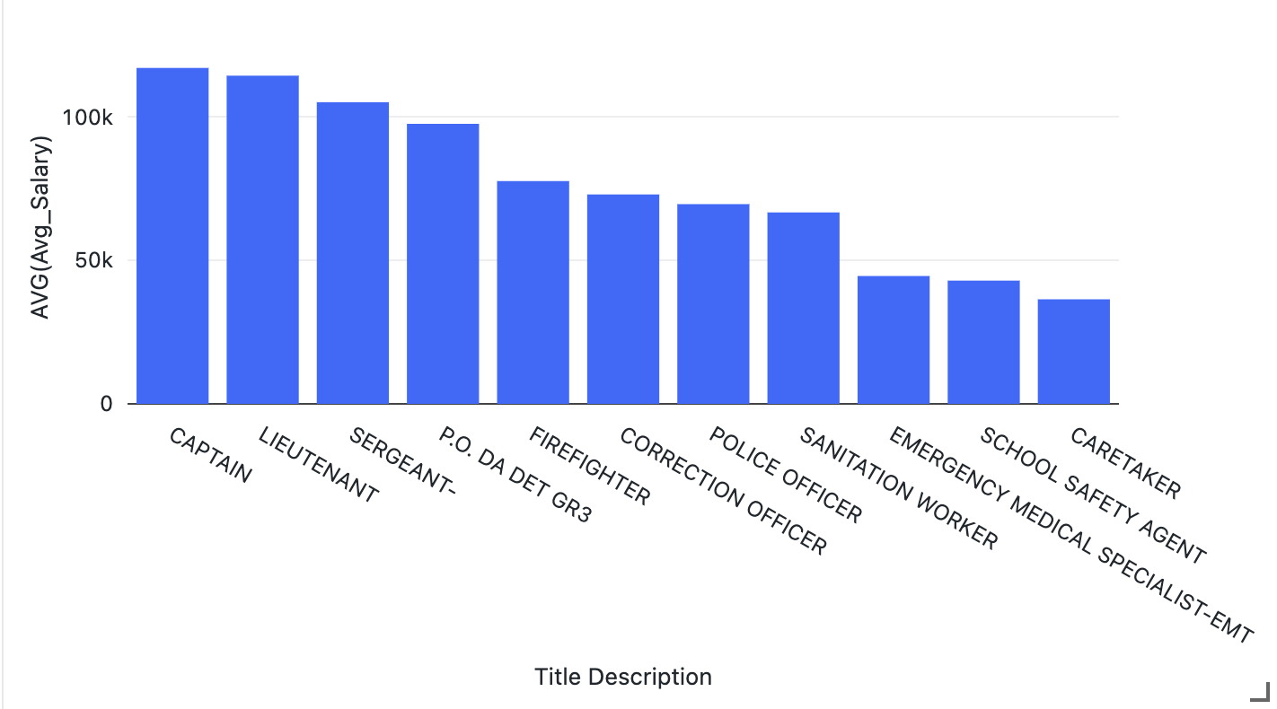
Job Title
Hypothesis:
Title Description and Years of Working will have the most impact on Regular Gross Paid

Slide 11
Preprocessing Data
Split Data into Training and Testing
1
String Indexer: Changing all categorical columns into index
2
Vector Assembler: Combining both string and numerical columns
3
Preprocessing makes it more suitable for the algorithm in the regression models

Slide 12
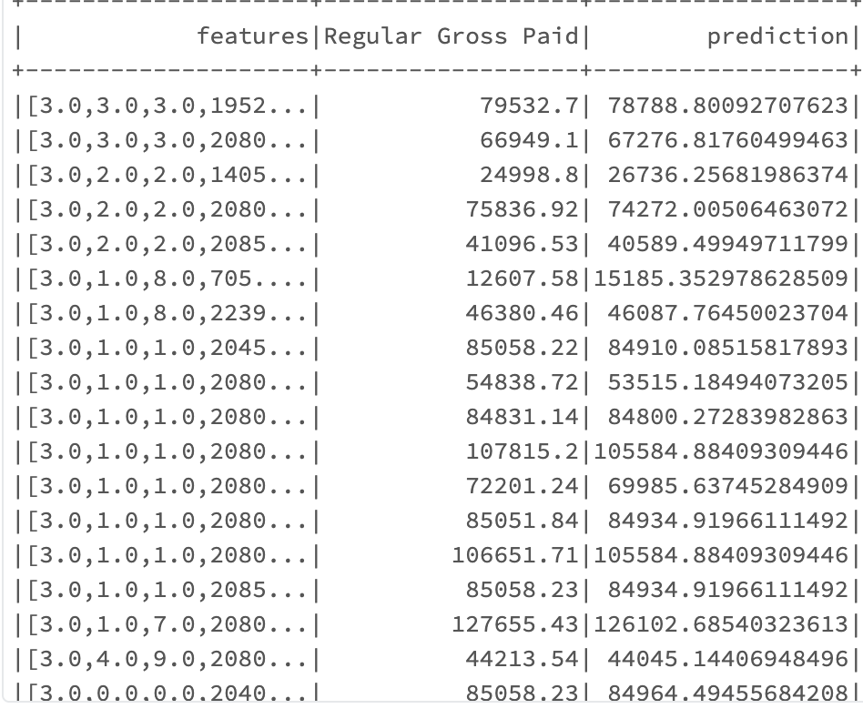
Gradient Boosted Tree Regressor
R2 .996
RMSE 1531.4
R2: the percent of the features that the model explains. High R2 means less variation between prediction and regular Gross Paid
High RMSE: the model has less precise predictions and more error

Slide 13
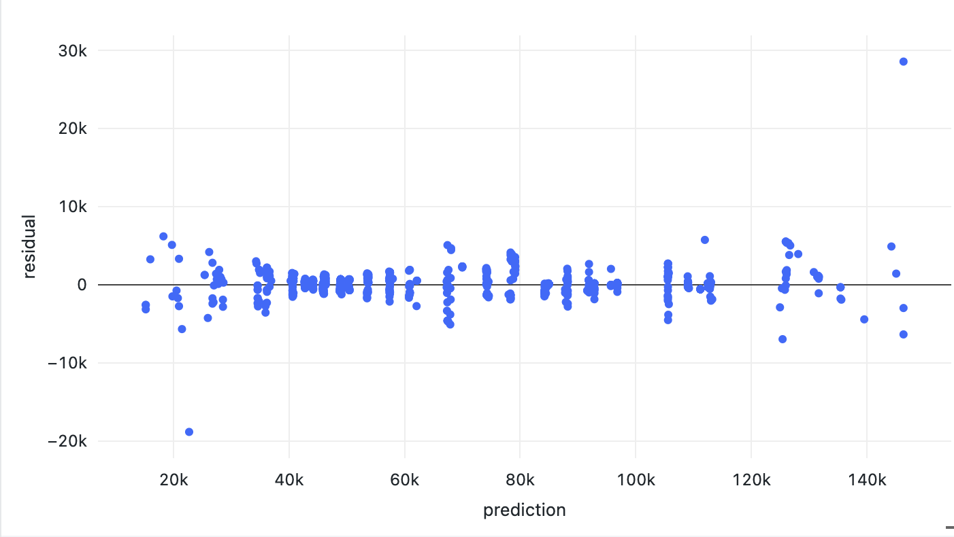
Residuals
Avg Residual = -1.5445
Small residuals mean the model’s predictions are closed to the actual value, and that it captured the patterns and relationships given in the data.
-Randomly scattered plot

Slide 14
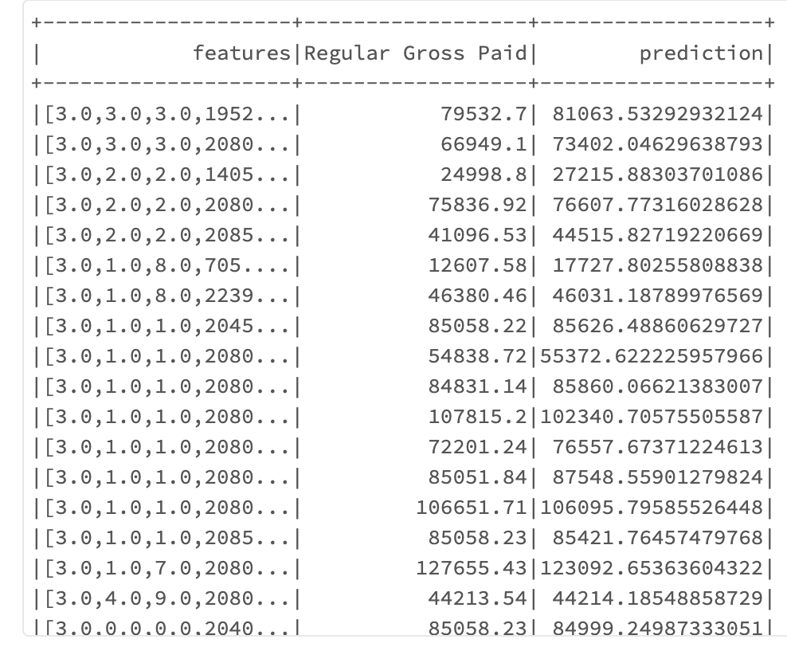
Random Forest Regression
RMSE 3508.23
R2 0.981
R2: the percent of the features that the model explains. High R2 means less variation between prediction and regular Gross Paid
High RMSE: the model has less precise predictions and more error

Slide 15
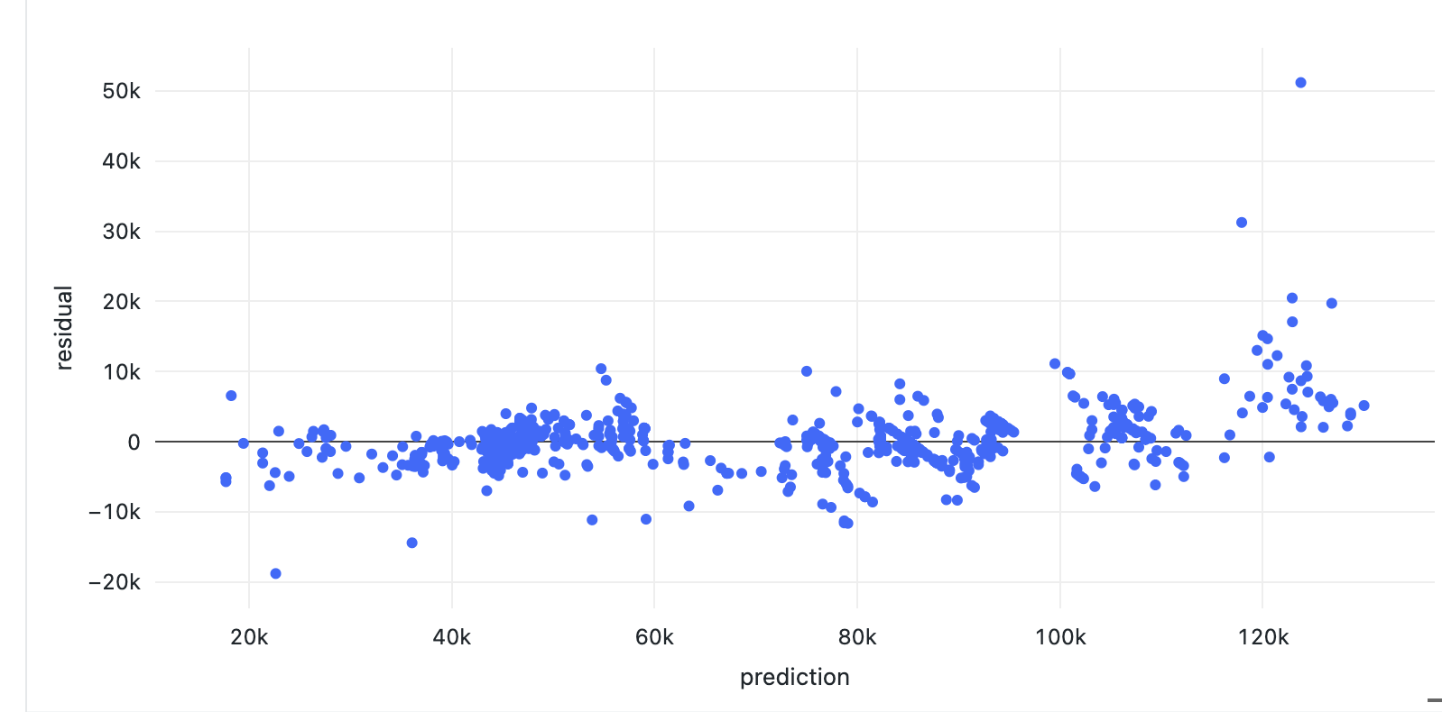
Residuals
Avg residual = - 3.716
Small residuals mean the model’s predictions are closed to the actual value, and that it captured the patterns and relationships given in the data.
-Randomly scattered plot

Slide 16
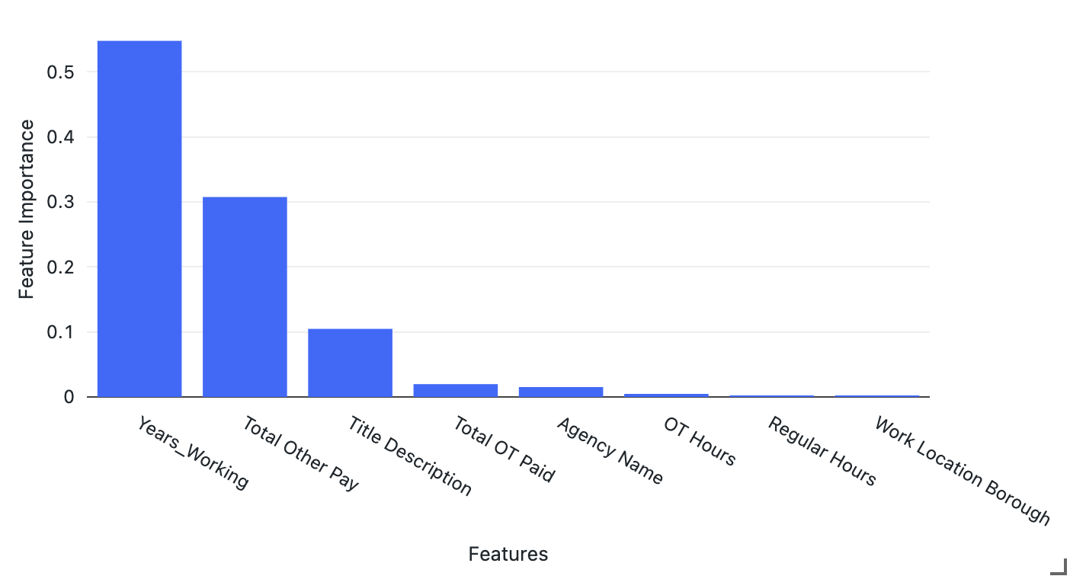
Feature Importance

Slide 17

Conclusion
Gradient boosted Trees regressor had better results than random forest regression, therefore that is the preferred model
Both models had high R2 meaning they are good predictors. The RMSE were high. GBT had significantly lower RMSE
RMSE could be lower with more boroughs, jobs, and agencies included.
-Limitations: Only some boroughs, agencies and jobs were included in the model due to curse of dimensionality. Predictions could only be made for those included in the data frame

